Slide 1
Simpson’s 1/3rd Rule of Integration
by
Dr. Md. Rajibul Islam
CSE, UAP

Slide 2

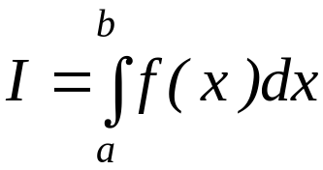
What is Integration?
Integration
y
f(x)
The process of measuring the area under a curve.
Where:
f(x) is the integrand
a= lower limit of integration
b= upper limit of integration
a
b
x

Slide 3
Simpson’s 1/3rd Rule

Slide 4
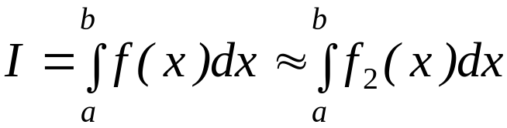


Basis of Simpson’s 1/3rd Rule
Trapezoidal rule was based on approximating the integrand by a first
order polynomial, and then integrating the polynomial in the interval of
integration. Simpson’s 1/3rd rule is an extension of Trapezoidal rule
where the integrand is approximated by a second order polynomial.
Hence
Where is a second order polynomial.

Slide 5
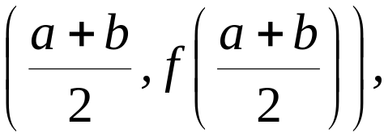



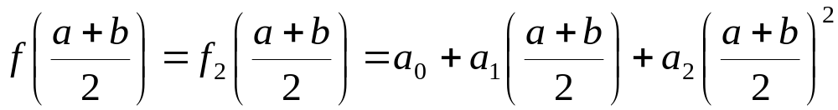

Basis of Simpson’s 1/3rd Rule
Choose
and
as the three points of the function to evaluate a₀, a₁ and a₂.

Slide 6
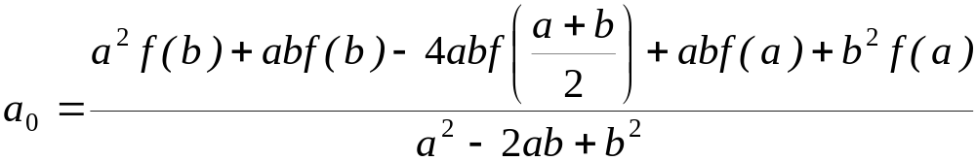
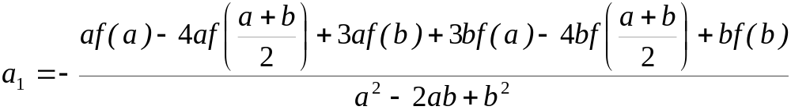
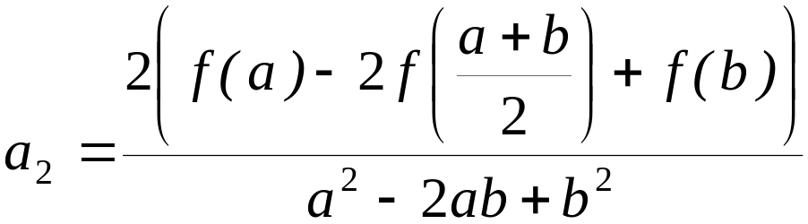
Basis of Simpson’s 1/3rd Rule
Solving the previous equations for a₀, a₁ and a₂ give

Slide 7
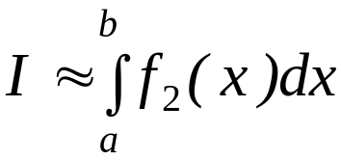
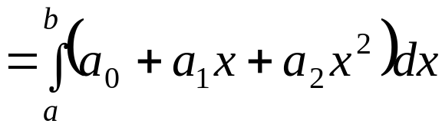
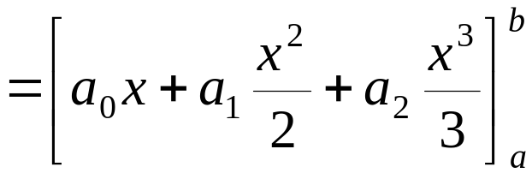
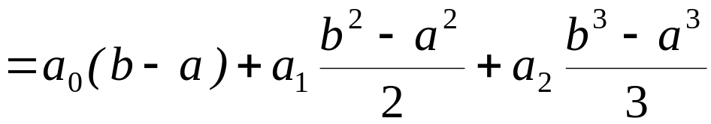
Basis of Simpson’s 1/3rd Rule
Then

Slide 8
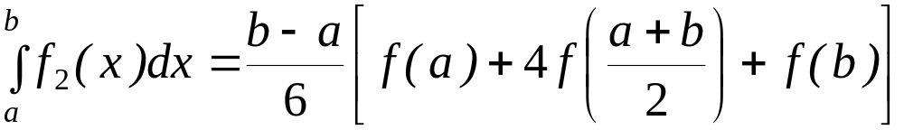
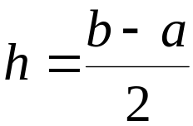
Basis of Simpson’s 1/3rd Rule
Substituting values of a₀, a₁, a ₂ give
Since for Simpson’s 1/3rd Rule, the interval [a, b] is broken
into 2 segments, the segment width

Slide 9
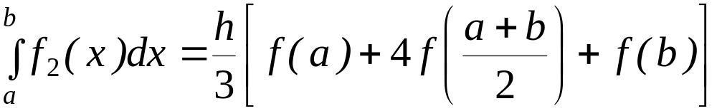
Basis of Simpson’s 1/3rd Rule
Hence
Because the above form has 1/3 in its formula, it is called Simpson’s 1/3rd Rule.

Slide 10
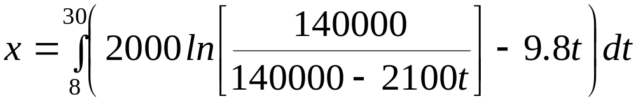


Example 1
The distance covered by a rocket from t=8 to t=30 is given by
a) Use Simpson’s 1/3rd Rule to find the approximate value of x
b) Find the true error,
c) Find the absolute relative true error,

Slide 11
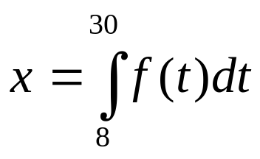
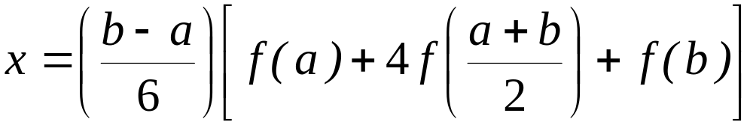
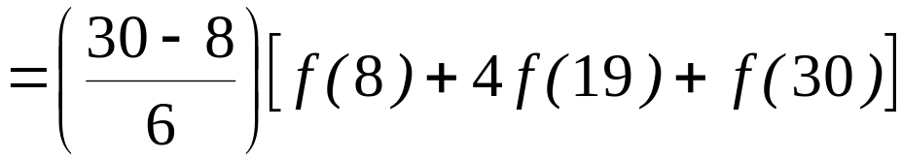
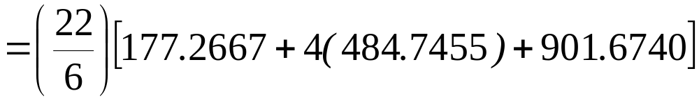

Solution
a)

Slide 12



Solution (cont)
b) The exact value of the above integral is
True Error

Slide 13
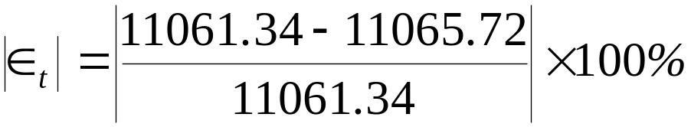

Solution (cont)
c) Absolute relative true error,

Slide 14
Multiple Segment Simpson’s 1/3rd Rule

Slide 15
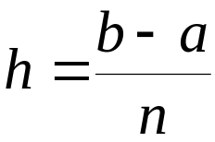
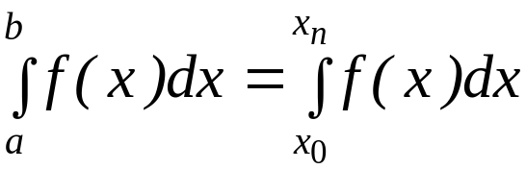


Multiple Segment Simpson’s 1/3rd Rule
Just like in multiple segment Trapezoidal Rule, one can subdivide the interval
[a, b] into n segments and apply Simpson’s 1/3rd Rule repeatedly over
every two segments. Note that n needs to be even. Divide interval
[a, b] into equal segments, hence the segment width
where

Slide 16
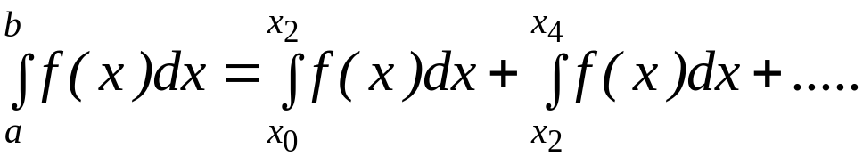
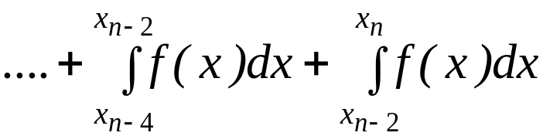
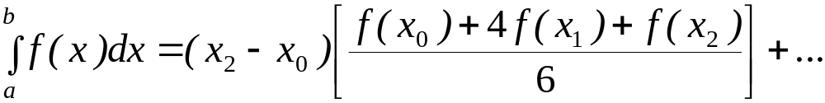
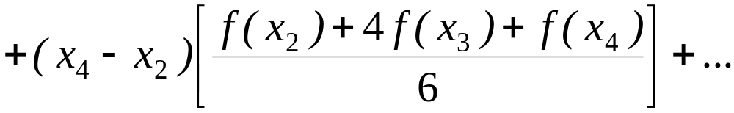
Multiple Segment Simpson’s 1/3rd Rule
f(x)
. . .
x
x₀
x₂
x_{n-2}
x_{n}
Apply Simpson’s 1/3rd Rule over each interval,

Slide 17
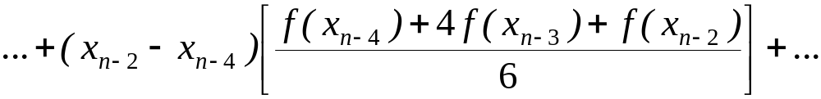
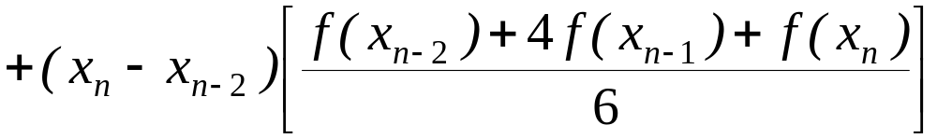


Multiple Segment Simpson’s 1/3rd Rule
Since

Slide 18
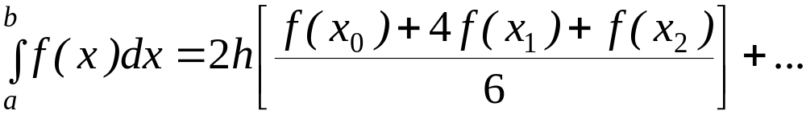
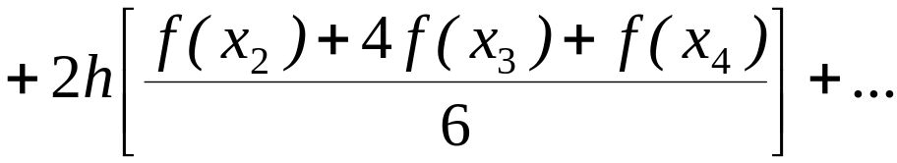
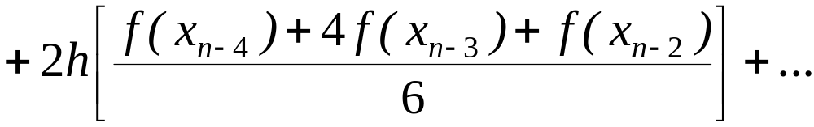
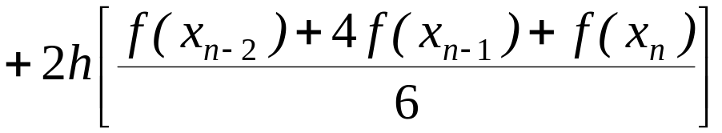
Multiple Segment Simpson’s 1/3rd Rule
Then

Slide 19
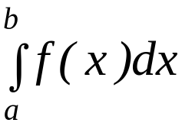
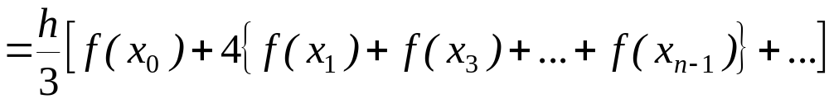
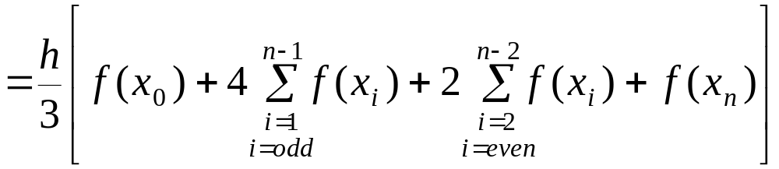
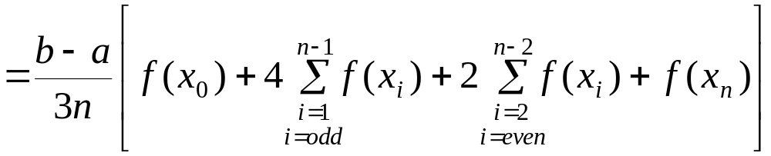
Multiple Segment Simpson’s 1/3rd Rule

Slide 20



Example 2
Use 4-segment Simpson’s 1/3rd Rule to approximate the distance
covered by a rocket from t= 8 to t=30 as given by
Use four segment Simpson’s 1/3rd Rule to find the approximate value of x.
Find the true error, for part (a).
Find the absolute relative true error, for part (a).

Slide 21
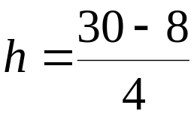










Solution
a)
Using n segment Simpson’s 1/3rd Rule,
So

Slide 22
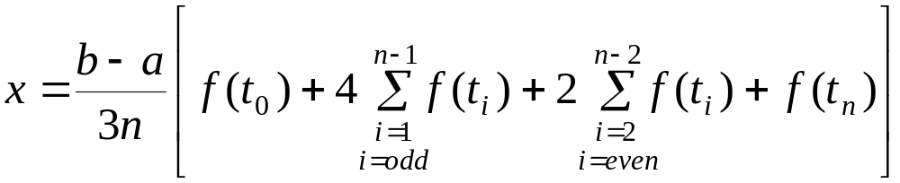
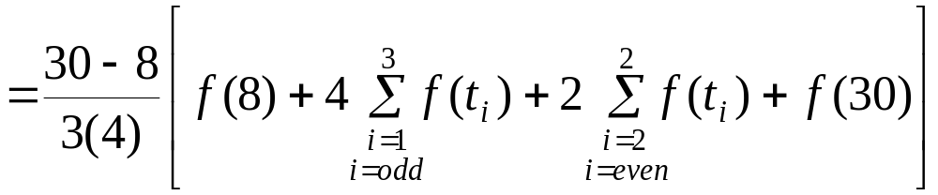
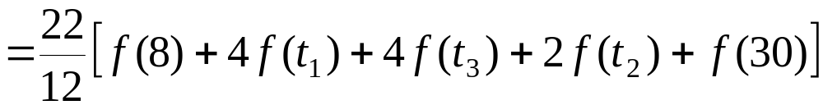
Solution (cont.)

Slide 23
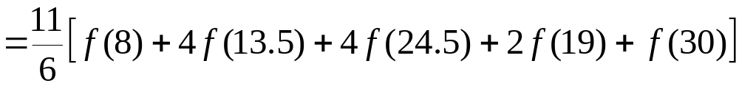

Solution (cont.)
cont.

Slide 24


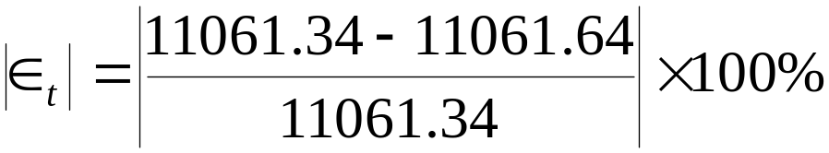

Solution (cont.)
In this case, the true error is
b)
The absolute relative true error
c)

Slide 25
Solution (cont.)
Table 1: Values of Simpson’s 1/3rd Rule for Example 2 with multiple segments
n | Approximate Value | E_{t} | |Є_{t} |
2 4 6 8 10 | 11065.72 11061.64 11061.40 11061.35 11061.34 | 4.38 0.30 0.06 0.01 0.00 | 0.0396% 0.0027% 0.0005% 0.0001% 0.0000%

Slide 26
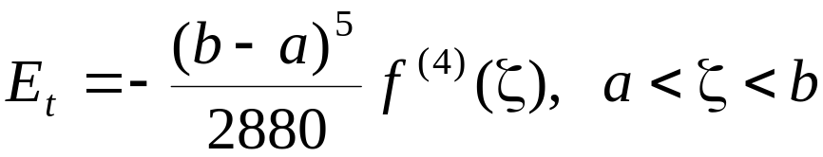
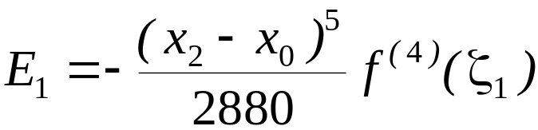
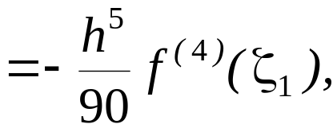

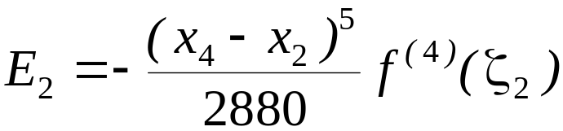
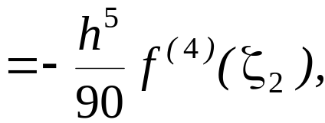

Error in the Multiple Segment Simpson’s 1/3rd Rule
The true error in a single application of Simpson’s 1/3rd Rule is given as
In Multiple Segment Simpson’s 1/3rd Rule, the error is the sum of the errors
in each application of Simpson’s 1/3rd Rule. The error in n segment Simpson’s
1/3rd Rule is given by

Slide 27
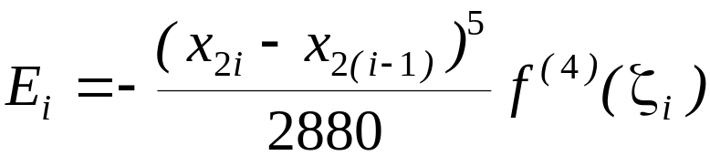
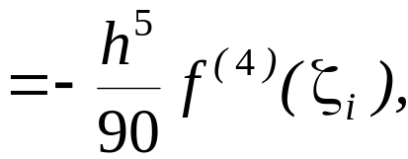

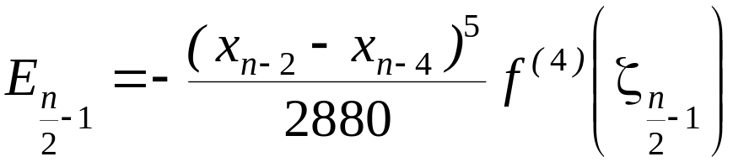





Error in the Multiple Segment Simpson’s 1/3rd Rule
.
.
.

Slide 28




Error in the Multiple Segment Simpson’s 1/3rd Rule
Hence, the total error in Multiple Segment Simpson’s 1/3rd Rule is

Slide 29




Error in the Multiple Segment Simpson’s 1/3rd Rule
The term
is an approximate average value of
Hence
where

Slide 30
THE END

